Slide 1
Action Planning with A.I.M.I.E.
From Screening Results to Implementing Effective Instruction in Less than 30 Minutes!

Slide 2
Purpose of this Session
To describe and explain the utility of a process for using the assessment results from SSIS SEL Brief + Mental Health Scales to directly link to instructional skill units in the SSIS SEH Classwide Intervention Program that are effective for improving students’ social emotional and healthy behaviors.
A key tool that can drive intervention thinking and decision making is the A.I.M.I.E. Action Plan Guide. A second tool designed to support implementation of a high-quality intervention is the Instructional Progress Monitor Record.
How to use of these two tools is the core of this training session. Both tools are embedded in SSIS assessment reports and are also available at SSIScolab.com.

Slide 3
Fundamental Premises about Assessment to Enable Better Intervention
The primary reason to conduct an assessment is to facilitate decision making that lead to effective actions for improving performance.
Effective instructional actions are easiest to identify when your assessment measures the same behaviors and skills you want to teach.
Effectiveness of one’s instructional action strategy is significantly influenced by the degree of integrity with which the action implemented.

Slide 4
SSIS Assessment Results are Actionable
The SSIS SEL Brief Scales and the SSIS SEL Brief + Mental Health Scales provide information for making decisions that lead to actions for improving students’ social emotional health.
A key design feature of these SSIS SEL assessments is that they measure specific behaviors and skills that are aligned with the core skills advanced in the CASEL Competency Framework (i.e., the domains of self-awareness, self-management, social awareness, relationship skills, and responsible decision making). Thus, score results from these assessments are actionable because they enable users to match at the SEL Competency domain level to any intervention program where its lessons have been demonstrated to be highly aligned with the five CASEL SEL competencies.
The matching of assessments and instructional lessons should be supported with validity evidence showing the SEL skills or behaviors assessed are the same as the specific skills taught in the SEL program. The SSIS SEH Classwide Intervention Program (SSIS CIP) is a program that meets this design standard and has 100% alignment to both the CASEL SEL Competencies and the SSIS SEL Brief Scales. The SSIS CIP is a proven intervention recognized as a CASEL SELect and a USDE What Works Clearinghouse Tier 1 Strong Program.
By using a CASEL SELect intervention program and valid assessment results from the SSIS SEL Brief Scales or Brief + Mental Health Scales, you are action plan ready! To develop your action plan, download the SSIS A.I.M.I.E. Action Plan Guide for increasing social emotional skills and decreasing emotional behavior concerns of all students.

Slide 5
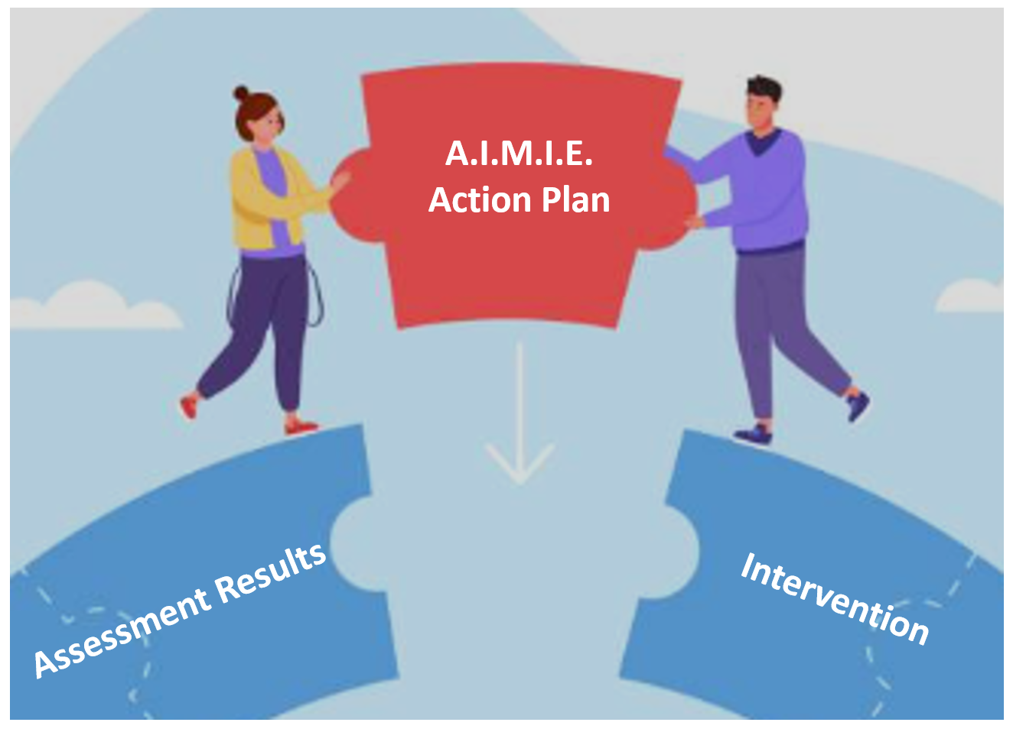
Connect SEL + MH Assessment Results to
a Proven Effective Intervention Program

Slide 6
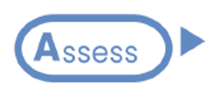
Who or What is A.I.M.I.E.?
A 5-step aligned process predicated on assessments and intervention that share a high percentage of content. That is, the behaviors and skills measured by the assessments are the same or very similar to the behaviors and skills taught in the intervention program. We call this content aligned!

Slide 7
The Steps in a Complete Action Plan
The SSIS A.I.M.I.E. Action Plan is a data-driven sequence of decision steps using the proven efficient and intervention sensitive SSIS assessments to link to SEL intervention programs aligned with the CASEL Competency Framework. Most CASEL SELect Programs provide many lessons that align well with the content assessed by the SSIS SEL assessments.
When you have SSIS assessment reports, you are ready for the Assess step where you focus on individual or groups of students’ scores and performance levels to determine relative strengths and areas for improvement. The Identify step follows and involves decisions regarding skill domain priorities (low, moderate, high) and the nature of the instructional goal (increase, maintain, decrease) for each priority domain.
The Match step follows and requires a thorough understanding of one’s intervention program to determine which lessons to teach the behaviors, skills, and attitudes prioritized for improvement. This matching process involves (a) knowing the content of the items assessed and (b) the content of the lessons taught. Persons knowledgeable of both the assessment and intervention program content are needed to complete this step.
The Implement step is influenced by users’ available time and the scope of the instruction. At a minimum, one’s intervention Start Date and End Date should be considered to organize how many of the lessons can be taught.
Finally, all intervention programs should be evaluated to determine if students made progress and achieved the expected outcomes. The Evaluate step requires the re-administration of the SSIS SEL assessment a week or two after the program’s End Date to determine the amount of improvement observed by comparing pre-intervention and post-intervention score results.

Slide 8
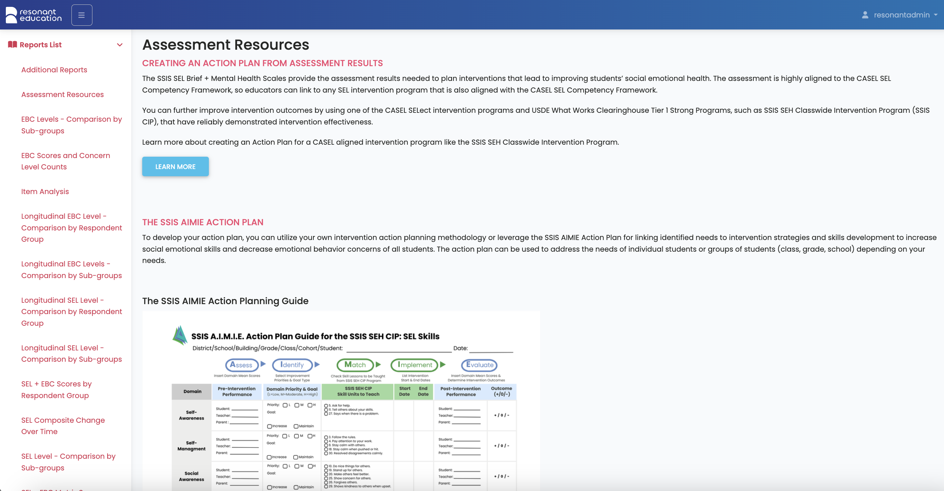
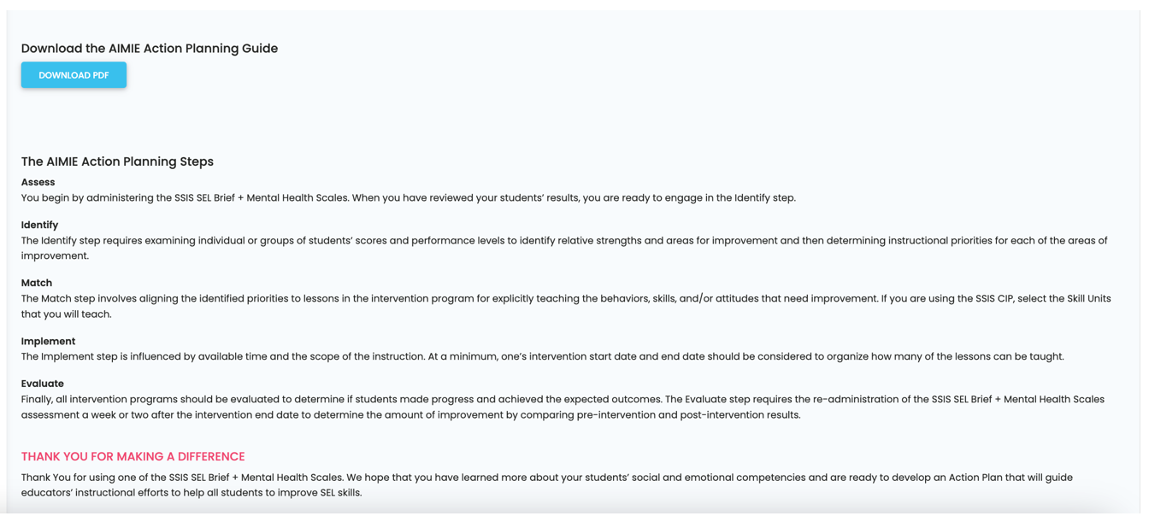
A downloadable version of A.I.M.I.E. is located under the Assessment Resources tab on the Reports List page of Resonant Education’s website.

Slide 9
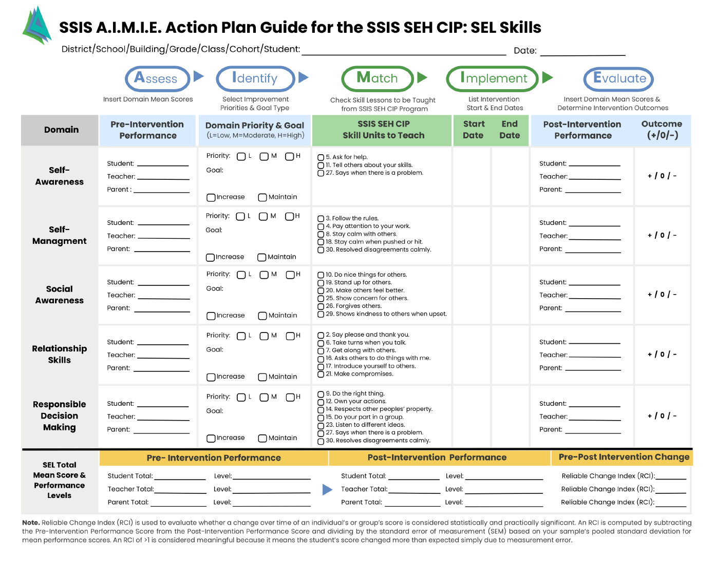
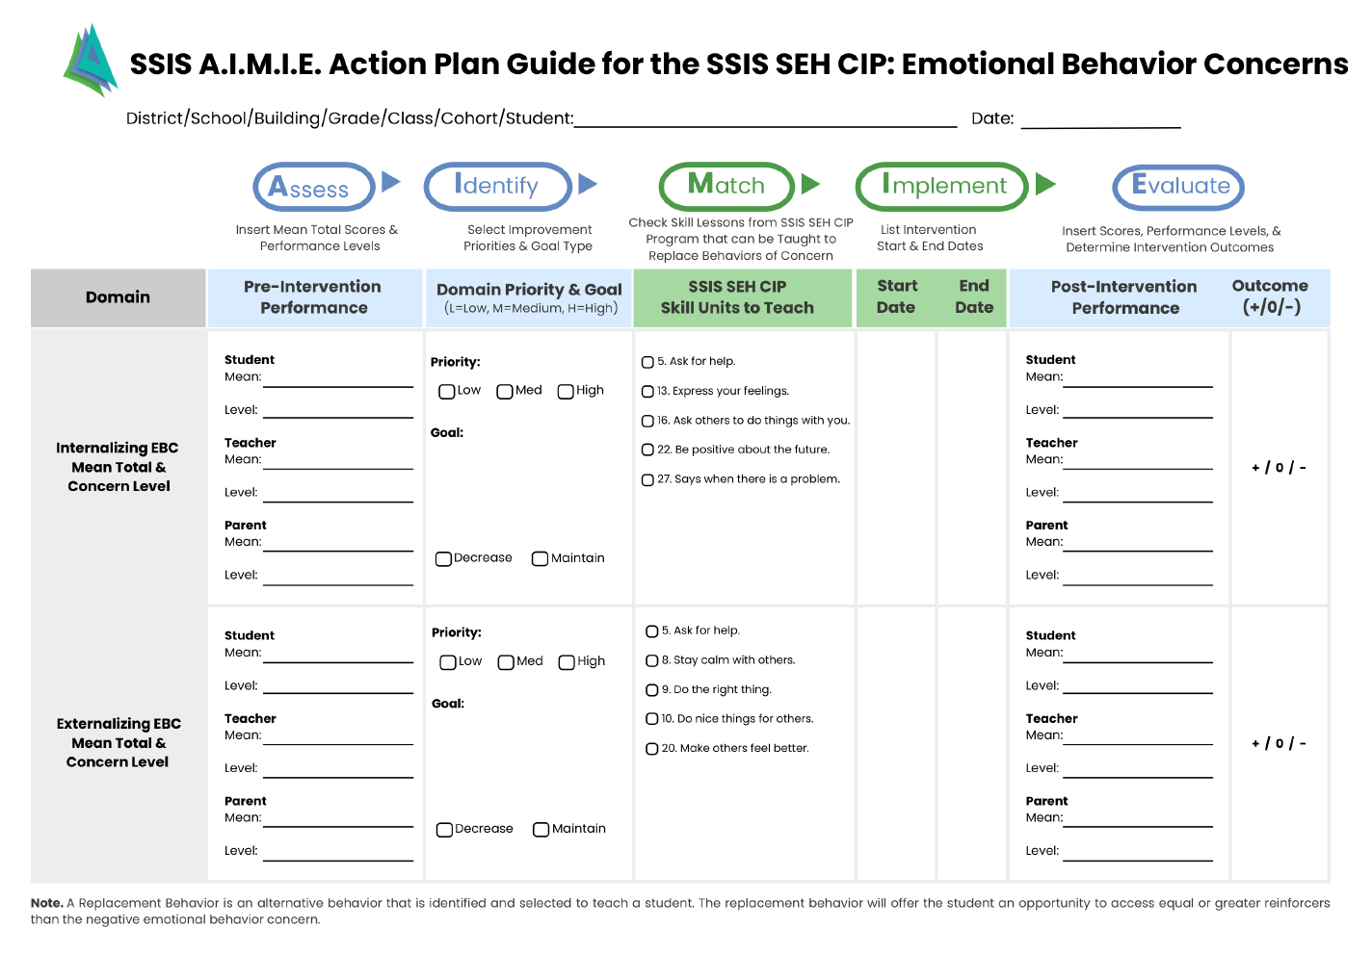
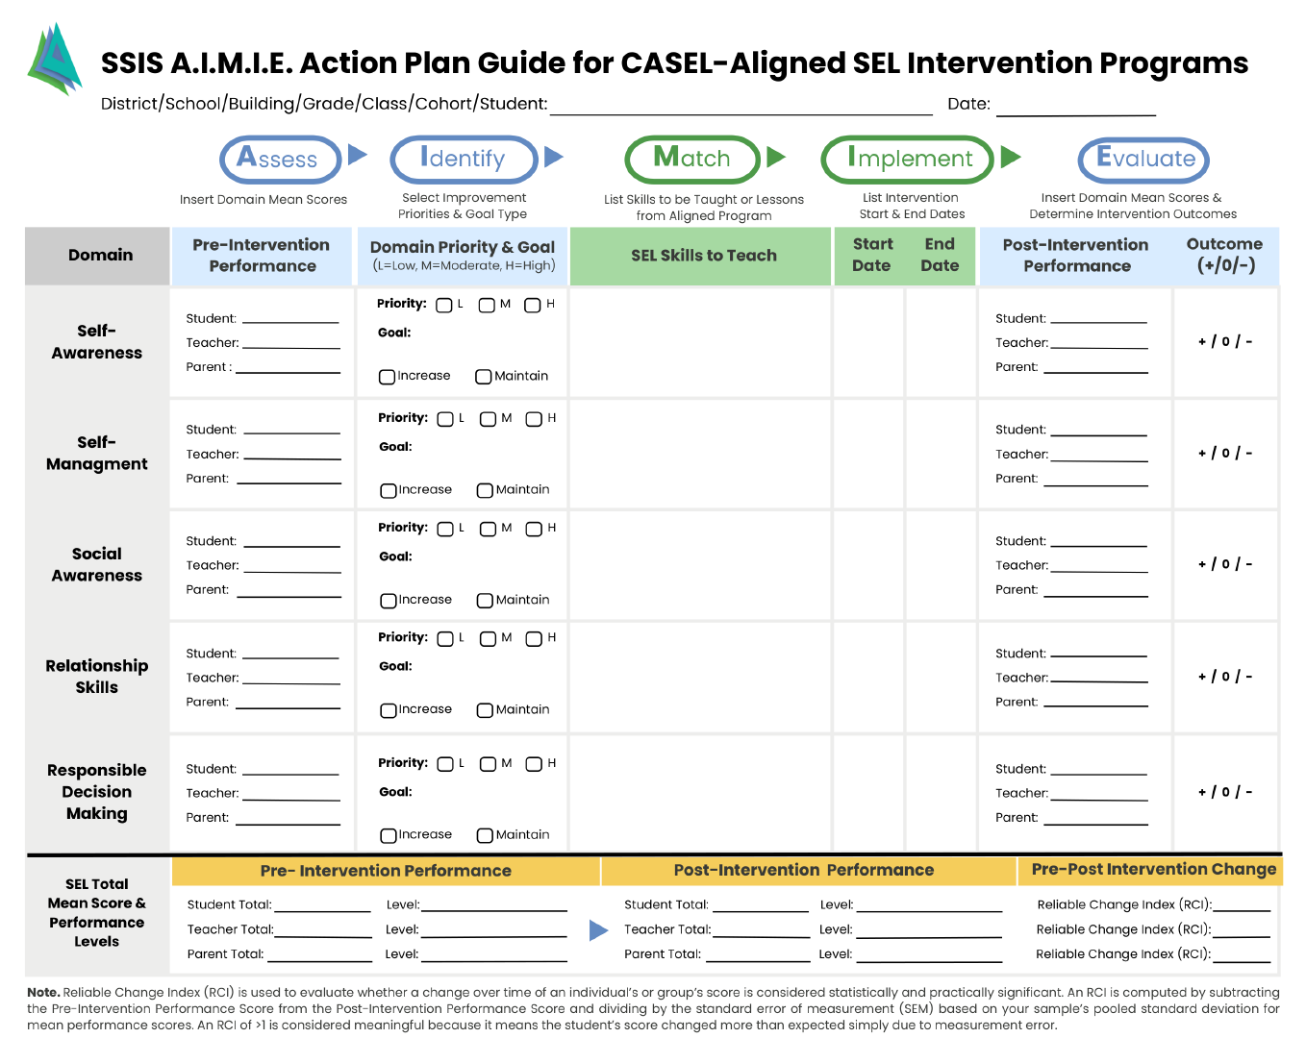
The 3-Page A.I.M.I.E. Action Plan Guide downloadable worksheet

Slide 10
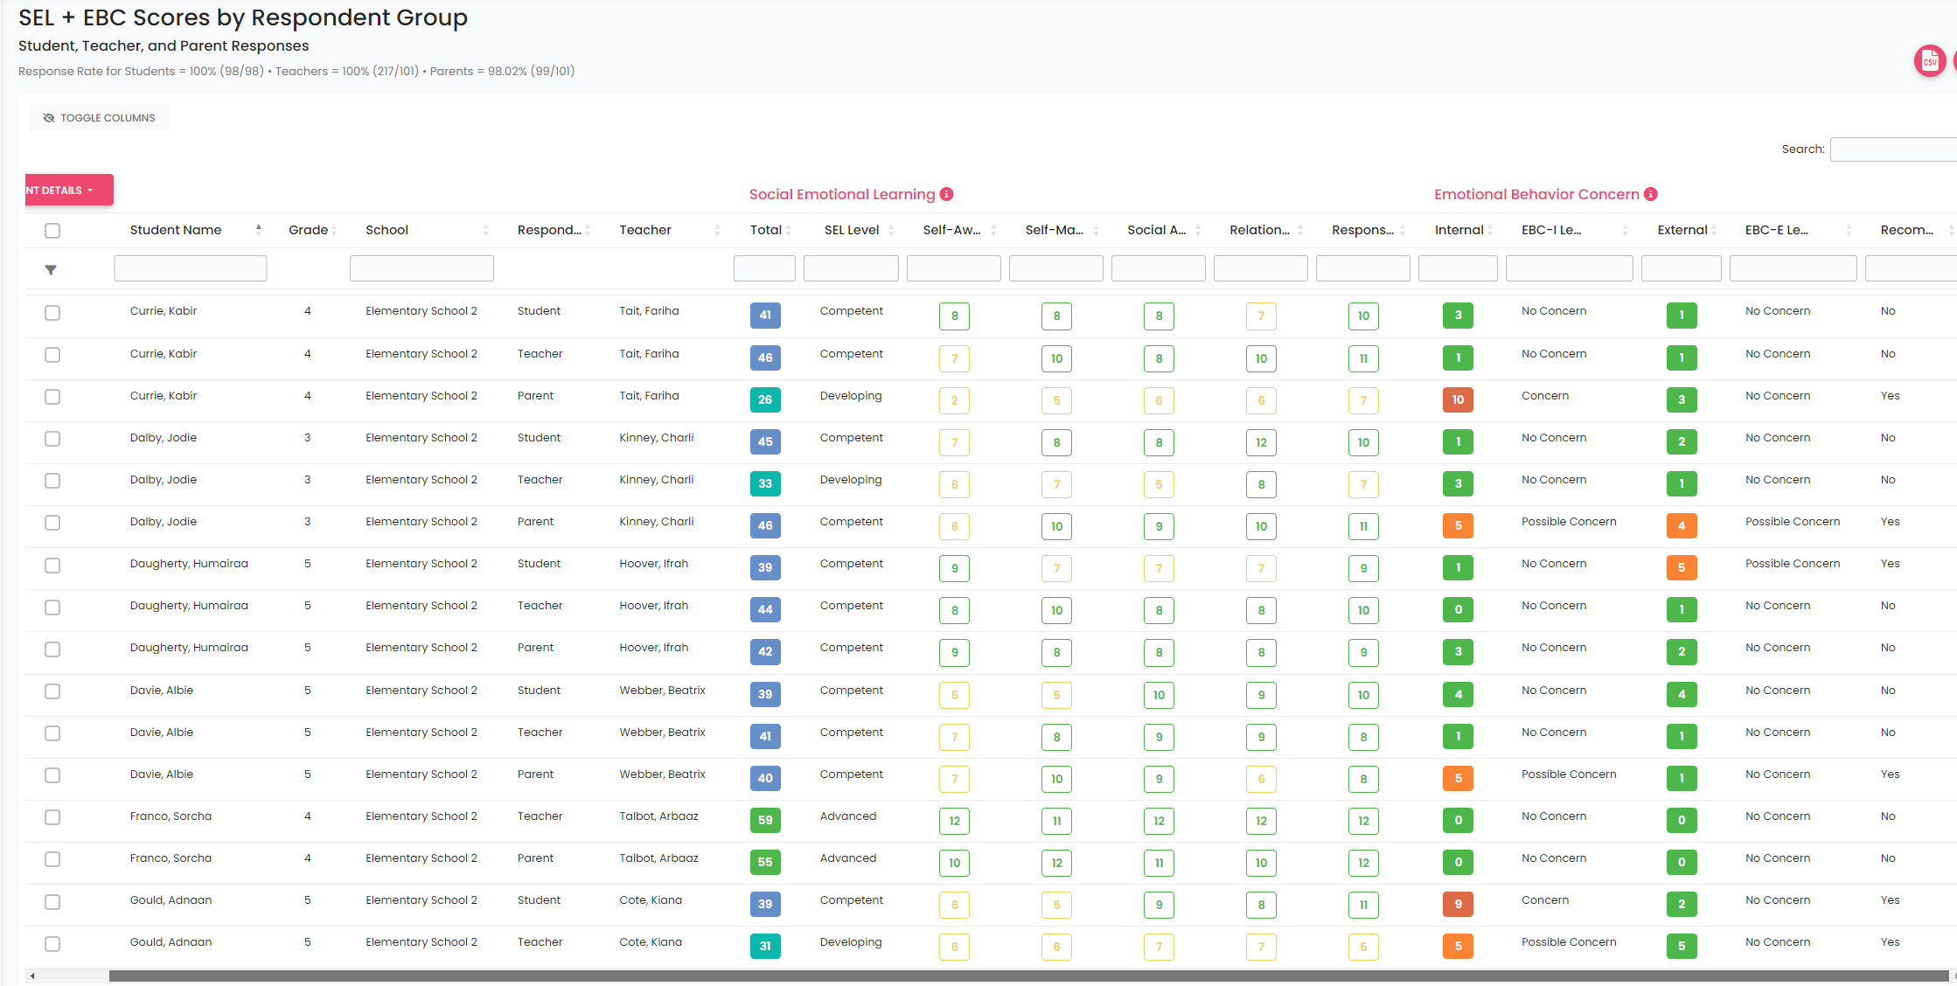
Score Results Reported as SEL Competency & Emotional Behavior Concern
Levels Activate the Development of and Intervention Plan
First Focus on Creating the Score Reports You Want to Process
Select the type of Report from the Reports List
Select the Run
Select the School
Using the Filters, select Respondent Group, etc.
This Results in a Score Report

Slide 11
Examine the Results for Adnaan Gould,
a 5th Grade Student
Observations
2 Respondents (Teacher & Student); no Parent rating
Total SEL scores by Student (39 or Competent) & by Teacher (31 or Developing) indicate some disagreement and room for improvement
Reasonable Agreement w/ Self-Awareness & Self-Management SEL domains as areas for improvement + Concerns about EBC-Internalizing

Slide 12
Download & Complete the Action Plan Guide.
To complete the Assess Step, transfer Adnaan G’s scores to the
Pre-Intervention Performance column.
To complete the Identify step you need to indicate the Domain Priority & Goal(s). Usually, relatively low SEL Domain scores are priorities to be improved.

Slide 13
Continue to Page 2 of the Action Plan to document scores and domain priorities for Emotional Behavior Concerns
Complete the Assess Step, transfer Adnaan G’s scores to the
Pre-Intervention Performance column.
Complete the Identify step you need to indicate the Domain Priority & Goal(s). Usually, relatively high EBC scores are priorities to be improved.

Slide 14
Continue to Complete
the Action Plan Guide by selecting SEH CIP Skill Lessons to Teach that Match (content aligned)
with Domain Priorities and Goals.

Slide 15
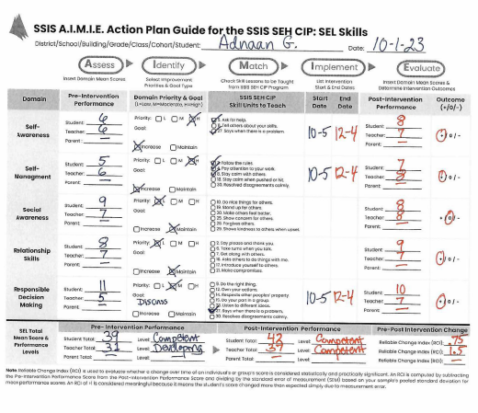
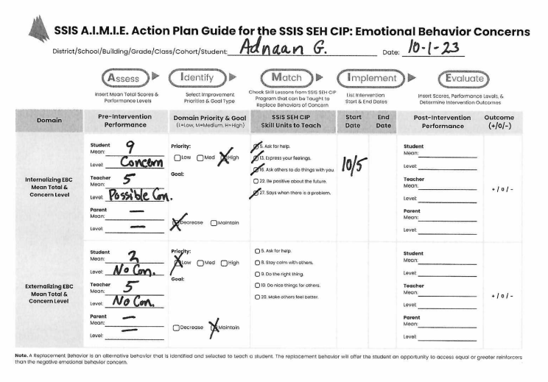
The Action Plan Documenting the A.I.M. Steps toward
Adaan’s SEL Skill & EBC Improvement Program

Slide 16
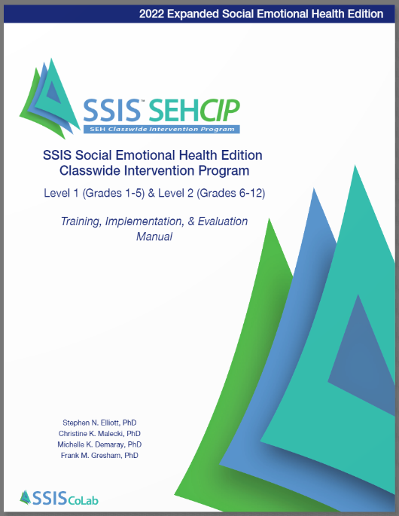
Lessons that Match Adnaan’s SEL & EBC Improvement Goals
The Match between the Domain Priorities and Goals resulting from the Assessment are easy and direct when the SSIS SEH Classwide Intervention Program is being used to teach SEL skills and more!
The skills checked in the Skill Lessons to Teach column all can be found online at SSIScolab.com.
In the case of Adnaan, here are some of the featured skill units he would be taught.
Each of the matches leads to a specific Skill Unit with 3 lessons that directly teaches the skill using a Tell-Show-Do-Practice-Monitor Progress-Generalize instructional approach operationalize via engaging PowerPoint slides.

Slide 17
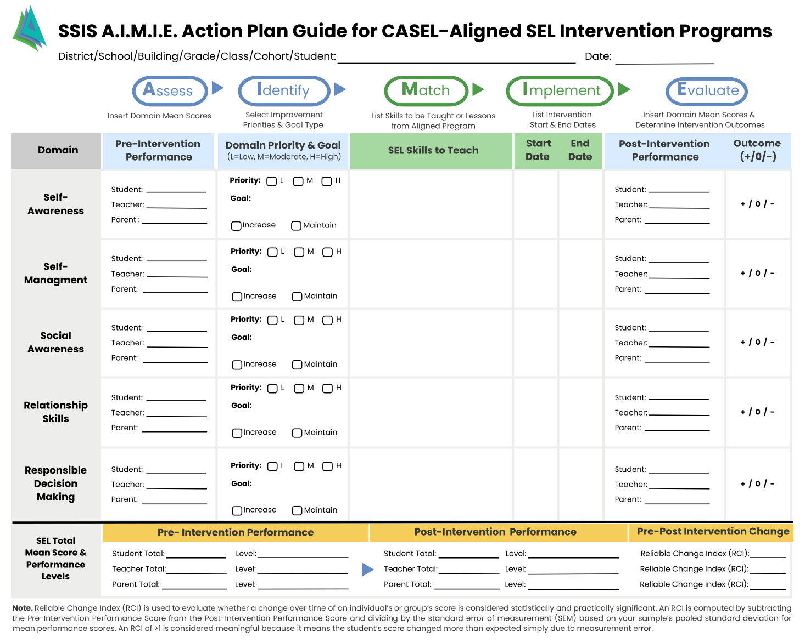
Specific versus General Matching of skill needs to skill lessons.
Assessment results from the SSIS SEL Brief Scales & SSIS SEL Brief + Mental Health Scales yield scores consistent with the CASEL Competency Framework. This enables these results to match with lessons from intervention programs that generally align with the CASEL Framework.
Page 3 of the A.I.M.I.E. Action Plan Guide can be used to identify matches with at the domain level with programs in addition to the SSIS SEH CIP.
The SSIS SEL Assessments Provide Results for Making Matches to Lessons with Many Other CASEL-Aligned Intervention Programs!

Slide 18
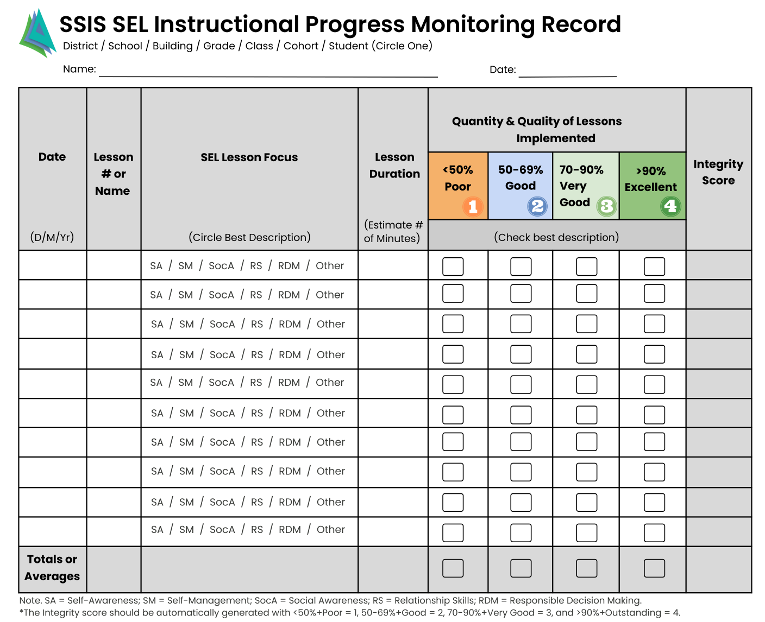
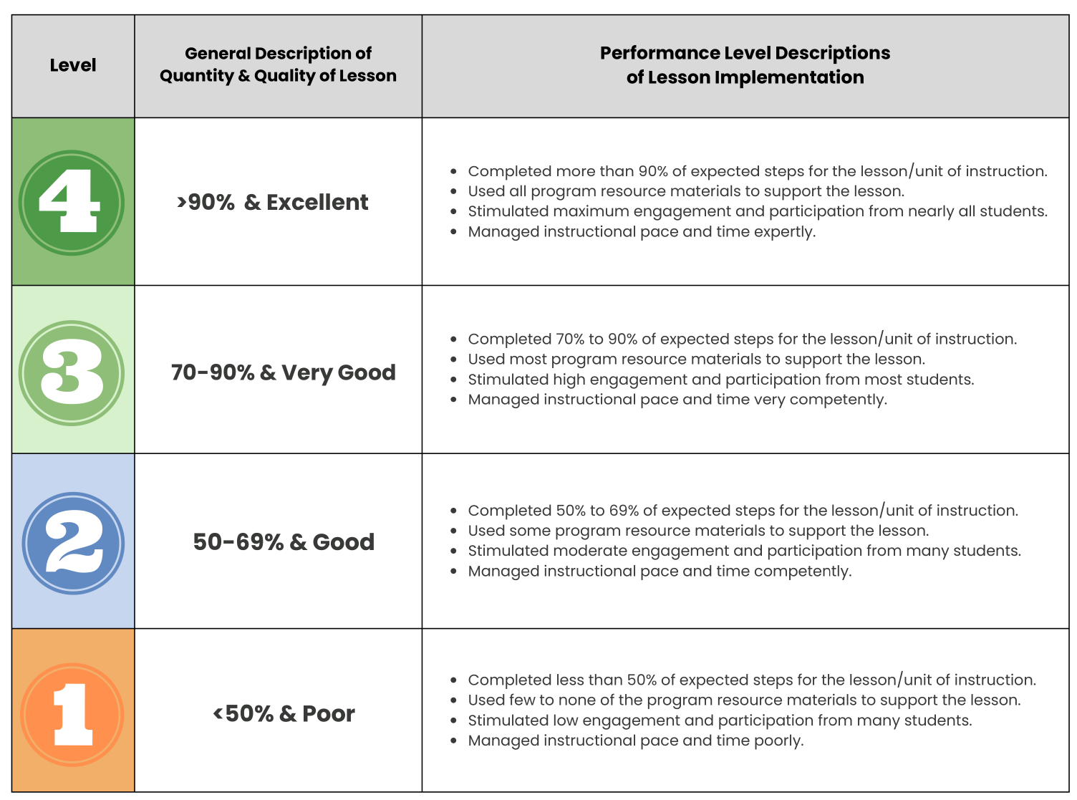
Instructional Integrity is a Key part of Implementation & Evaluation Steps
The Implement & Evaluation steps involve decisions about instructional actions and effects.
The SSIS SEL Instructional Progress Monitoring Record is a downloadable tool that helps interventionists plan, document, and evaluate SEL lessons taught.
It is typical used as a self-report tool, but also can be used by an independent observer to provide inter-rater reliability evidence.

Slide 19
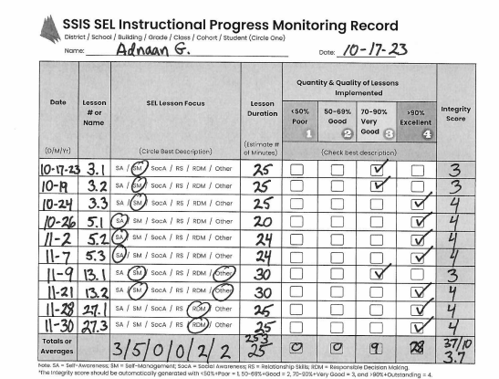
The Completed IPMR by Adnaan’s Teacher
Key Observations
& Conclusion
SSIS CIP Lessons to teach & practice 4 SEL skills were completed in a 2-month period.
The Integrity with which these lessons were implemented was considered Very Good to Excellent based on a 3.7 average Integrity Score.
It is reasonable to conclude that any changes reported in the student’s could be due in part to these SEL Program lessons.

Slide 20
We conduct assessment to determine if students improve their SEL skills from Pre- to Post-Intervention.
When pre- and post-assessments are (1) highly aligned with the skills taught in an intervention and (2) the intervention has been shown to be implemented with integrity, the results of the assessments can be used to determine if students’ skills improved.
As illustrated by the Evaluate step, Post-Intervention SEL scale/domain scores and total scores are used to determine outcomes & calculate a Reliable Change Index (RCI).
The Last Step: Evaluate (and Calculate) to Determine Outcomes

Slide 21
The Complete Post-Intervention Action Plan for Adnaan
Key Observations
& Conclusion
The combined SEL ratings by the student and his teacher indicate slight improvement in targeted Self-Awareness, Self-Management, and Responsible Decision-Making skills.
The student’s and teacher’s Post-Intervention total SEL scores indicated the student is functioning at the Competent Level social emotionally.
The SEL Total Scores based on the teacher ratings indicated a Reliable Change from Pre- to Post-Intervention occurred. The RCI was 1.5.
It can be concluded that the intervention program helped Adnaan improve targeted SEL skills.

Slide 22
Application Summary

Slide 23
Use A.I.M.I.E. to Create Action Plans for Individual Students, Small Groups, Entire Classrooms, & Schools
This training presentation demonstrated the application of the SSIS SEL A.I.M.I.E. Action Plan for the case of Adnaan, a 5th grade student. SSIS SEL Brief + Mental Health Scales rating scores by Adnaan and his teacher were used in combination to identify the student’s behavior domains for improvement. The domains for improvement were then specifically matched with SEL lessons in the CASEL aligned SSIS SEH CIP and targeted for implementation and evaluation.
The exact same Action Planning Process used for Adnaan can be used to plan instructional intervention programs for small groups of students, entire classrooms of students, entire grade levels within a school, or an entire school of as long as you have assessment data that has been aggregated and averaged based on all the participating students.
Many SEL or SEH intervention programs are time consuming, and educators need to make decisions about what lessons to prioritize or to emphasis. Thus, results of the A.I.M.I.E. Action Plan can help educators organize their decision process and document the evidence-base for making lesson implementation selections.

Slide 24
The 5-Step A.I.M.I.E. Process Should be Recurring so that Assessment + Intervention Results Drive Future Instruction
Assess
Identify
Match
Implement
Evaluate
SSIS SEL assessments
provide ACTIONABLE data to drive an efficient
Intervention decision making process!

Slide 25
Make connections with the SSIS SEL A.I.M.I.E. to “bridge the gap” between assessment results and intervention implementation!

Slide 26
Thank You for using one of the SSIS SEL Brief + Mental Health Scales and/or the SSIS SEH Classwide Intervention Program. Both of these products are evidence based and designed to work together to maximize instructional programs that can improve students’ social emotional development.
The SSIS A.I.M.I.E. is a keystone resource based on solution focused thinking. Use it to enhance communication, documentation, and outcomes for your students!
For more information and resources to help you develop
an SSIS Action Plan, visit
https://ssiscolab.com/actionplans/

